Slide 1


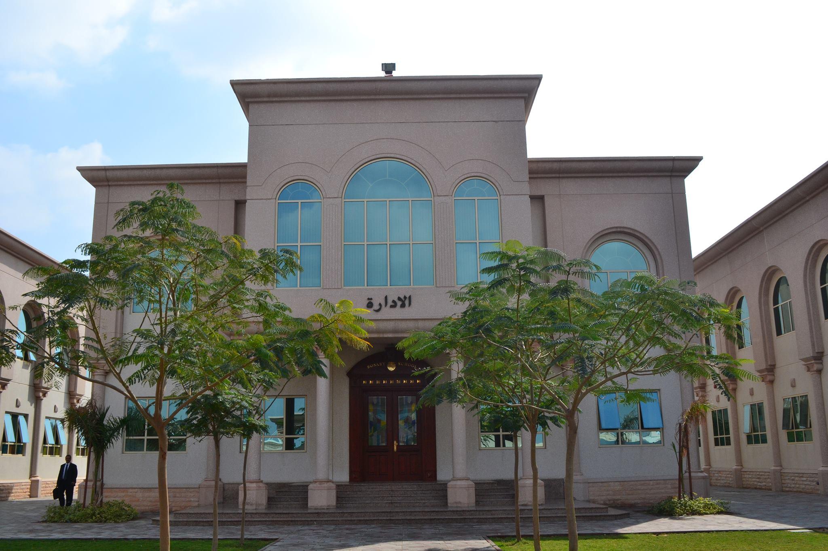
Rosary Private School -Sharjah (Muwaileh )

Slide 2
Welcome
IGCSE
Orientation
Subject options
Date: 25/04/2024

Slide 3

Rosary Private School – Sharjah
(Muwaileh) is a fully approved CIE Centre licensed to conduct IGCSE,AS and A Level examinations since 2004
Centre No: AE191

Slide 4

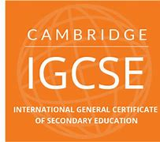
CIE Examinations
IGCSE / AS LEVEL / A Level
Y10 to Y13

Slide 5

What is Cambridge IGCSE ?
(CIE) Cambridge International Education
IGCSE : International General Certificate of Secondary Education
A two-year curriculum programme with External Examinations in Y10 and Y11.
The world’s most popular International qualification for 14 - 16-year-olds.
Taught in over 10,000 schools in more than 160 countries.
Cambridge IGCSE provides an excellent preparation for the Advanced levels (AS/A) .
Over 70 subjects available
Qualifications are accepted and recognised around the world.
Assessment takes place at the end of the course and includes written ,oral, and
Practical(in some subjects).
Equivalent to the GCSE in the UK.

Slide 6
Which subjects can I take ?
Hard work always pays off ; But plan before to start hard work.
Y10 is very important phase as it marks the beginning of the IGCSE examinations courses will be examined at the end of Y11. So, you have to make a vital choice about the subjects you will study. A choice of subjects entirely depends on your future goals. Before choosing subjects, you should think carefully about the following points:
What are my favorite subject ?
What am I good at ?
What do I need for future A Level choices ?
Do I have a balance of subjects – am I keeping my choices broad? (Careers change and many new careers have come on board)

Slide 7
Rosary School offers
IGCSE Subjects:
Mathematics
Biology
Physics
Chemistry
Business Studies
Economics
ICT
Arabic 1st Language
English 2nd Language
French (Foreign Language)
Environmental Management
History
Geography
Psychology (Edexcel )
Ministry Subjects
Arabic
Islamic Studies
Social studies
Moral Education
Physical Education
Notes:
Some IGCSE students wants to appear more than 5 subjects, they can take additional subjects in Oct- Nov. 2021.

Slide 8
Compulsory Subjects
IGCSE
English
Mathematics
ICT
Ministry of Education
Arabic
Islamic Studies
UAE Social Studies
Moral Education
Physical Education
Note: Islamic study only compulsory for Muslim Students.

Slide 9
Select either A or B
OPTIONS
A
B
Biology
Chemistry
Business Studies
Economics
OR
And ONE from C, D and E
C
D
E
Physics
1st Language Arabic
French Foreign Language
History
Environmental Mgt
Geography
Psychology (Edexcel)

Slide 10
IGCSE Result Grades
A*
A
B
C
D
E
F
G
U
Note: Equivalency will be till Grade E

Slide 11
Important Points to Remember
The IGCSE programme begins in Y10 and is completed at the end of Y11(2 Years Programme)
The equivalency of the certificate requires to complete 5 IGCSE subjects(excluding Arabic) all with a minimum E grade.
Mathematics and English must be two of the five.

Slide 12
Schedule for Examinations
CAIE conducts IGCSE examinations in two series :
May – June 2025
Registration in December
Practical Examinations ( March & April)
Written Examinations : May & June
Result in August
Certificates : Mid- October
Oct – Nov. series
Registration in July
Practical Examinations ( Sep/Oct.)
Written Examinations : Oct. & Nov.
Result in January
Certificates : Mid of March
Only a few subjects have Oct-Nov retakes.

Slide 13


Want to Know More
Look at the Options booklet on School Voice.
Talk to subject teachers if you want more information
Talk to your parents, people you know who have studied the subjects etc
The DEADLINE FOR RETURN OF FORMS IS THURSDAY 2ND MAY

Slide 14

Questions?
Email: rosarydg@yahoo.com

Slide 15
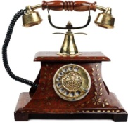
Link Option form
Click me for download (OPTION FORM)
THANK YOU

